Slide 1
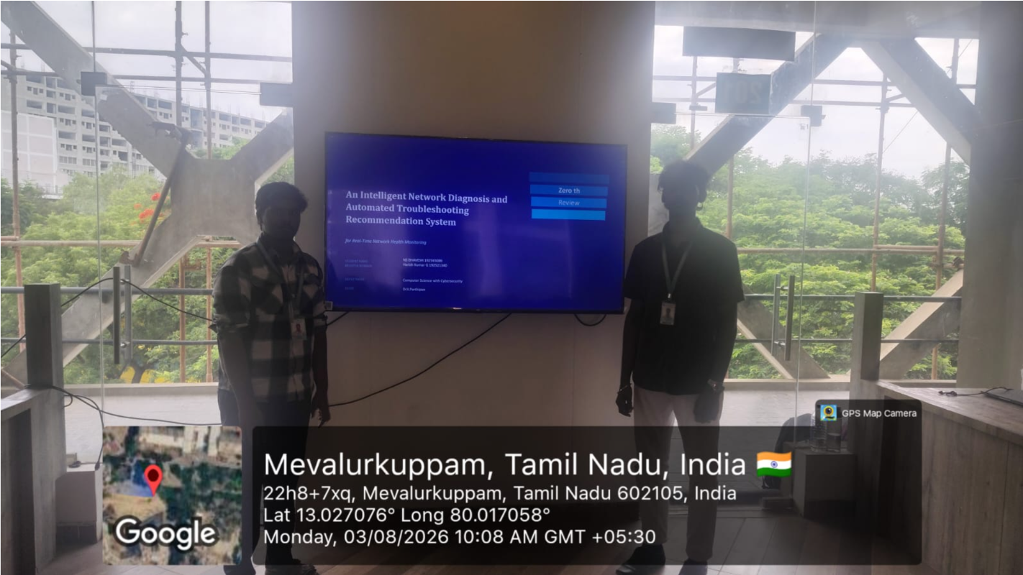

Slide 2
Zero th
FINAL YEAR PROJECT
An Intelligent Network Diagnosis and Automated Troubleshooting Recommendation System
Review
for Real-Time Network Health Monitoring
STUDENT NAME
NS BHAVESH
REGISTER NUMBER
192565086
DEPARTMENT
Computer Science with Cybersecurity
GUIDE
Dr.V.Parthipan

Slide 3
Introduction
1
Networks are essential for communication
Manual network troubleshooting is time-consuming
Delayed fault detection causes downtime
An intelligent monitoring system improves reliability

Slide 4
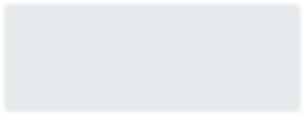
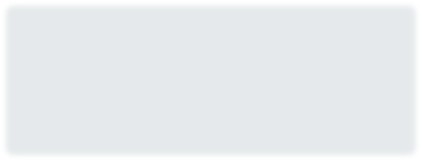
Problem Statement
2
1
2
Continuous Manual Effort
Manual monitoring requires constant human attention.
Slow Fault Identification
Network faults are difficult to identify quickly.
3
4
Performance Impact
Delayed troubleshooting affects overall performance.
No Automation
Lack of automated diagnosis and recommendations.

Slide 5




Aim & Objectives
3
AIM
Develop an intelligent system to monitor network health and recommend troubleshooting solutions.
OBJECTIVES
Monitor network performance
Detect network faults
Diagnose network issues
Recommend troubleshooting solutions
Generate network health reports

Slide 6


Proposed System
4
1
2
3
Real-Time Monitoring
Intelligent Diagnosis
Auto Recommendations
Continuous tracking of network health
Automated fault identification
Suggested troubleshooting steps
4
5
Status Dashboard
Report Generation
Live view of network condition
Health reports for review

Slide 7
Module 1 – Real-Time Monitoring
5
1
Device discovery
2
Ping monitoring
3
Latency measurement
4
Packet loss detection
5
Bandwidth monitoring
6
Live dashboard

Slide 8
Module 2 – Intelligent Diagnosis
6
1
Rule-based fault detection
2
Root cause analysis
3
Network issue classification
4
Severity level calculation
5 Network health score

Slide 9
Module 3 – Troubleshooting & Reporting
7
1
Troubleshooting recommendations
2
Alert notifications
3
Network health reports
4
Performance history
5 Administrator dashboard

Slide 10
Software & Tools
8
Programming Language Python
GUI Tkinter / Flask
Database SQLite
IDE VS Code
Libraries psutil, ping3, matplotlib, pandas

Slide 11
Expected Outcome & Future Scope
EXPECTED OUTCOME
FUTURE SCOPE
Continuous network monitoring
AI-based fault prediction
Faster fault detection
SNMP integration
Cloud monitoring
Automated troubleshooting recommendations
Mobile application
Reduced network downtime
Email / SMS alerts
Thank You

